Slide 1

Build your own agent with OpenAI, .NET and Copilot Studio
Gomolemo Mohapi
Cloud Developer Advocate
In partnership with

Slide 2
We are going to be building an agent

Slide 3

What is an agent?
Agents use AI to automate and execute business processes, working alongside or on behalf of a person, team or organisation
Deploy to…
Microsoft 365 Copilot
Your applications
Your websites

Slide 4



Podcast Marketing Agent with Azure OpenAI Service, .NET, and Copilot Studio
Laying the Foundation: Azure OpenAI Service
Bridging the Gap: .NET APIs and Custom Connectors
Final Touch: Microsoft Copilot Studio integration

Slide 5

Azure OpenAI Service
Cutting-Edge AI Models
Pioneering Research and Advancements
Unlocking New Creative Possibilities
Secure Data and Built-In Responsible AI
Global Availability and Flexibility
Developer-Friendly Integrations
Reasoning & Multimodal
text, image, audio
Fine Tuning
Images
Transcription & Translation
o1
o1-mini
o3-mini
GPT-4.5
GPT-4o
GPT-4o mini
GPT-4o GPT-4o mini
DALL·E 3
Whisper
Connect Your Data
Responses API
Azure AI Agent Service
Computer Use Agent

Slide 6











.NET
.NET
Cloud
Web
Desktop
Mobile
Gaming
IoT
AI
+
+
Visual Studio
Visual Studio Code
CLI
GitHub Copilot
Windows
Linux
macOS
NuGet
GitHub
.NET Aspire
Components, tools, library vendors
Tools
Operating system
Ecosystem

Slide 7

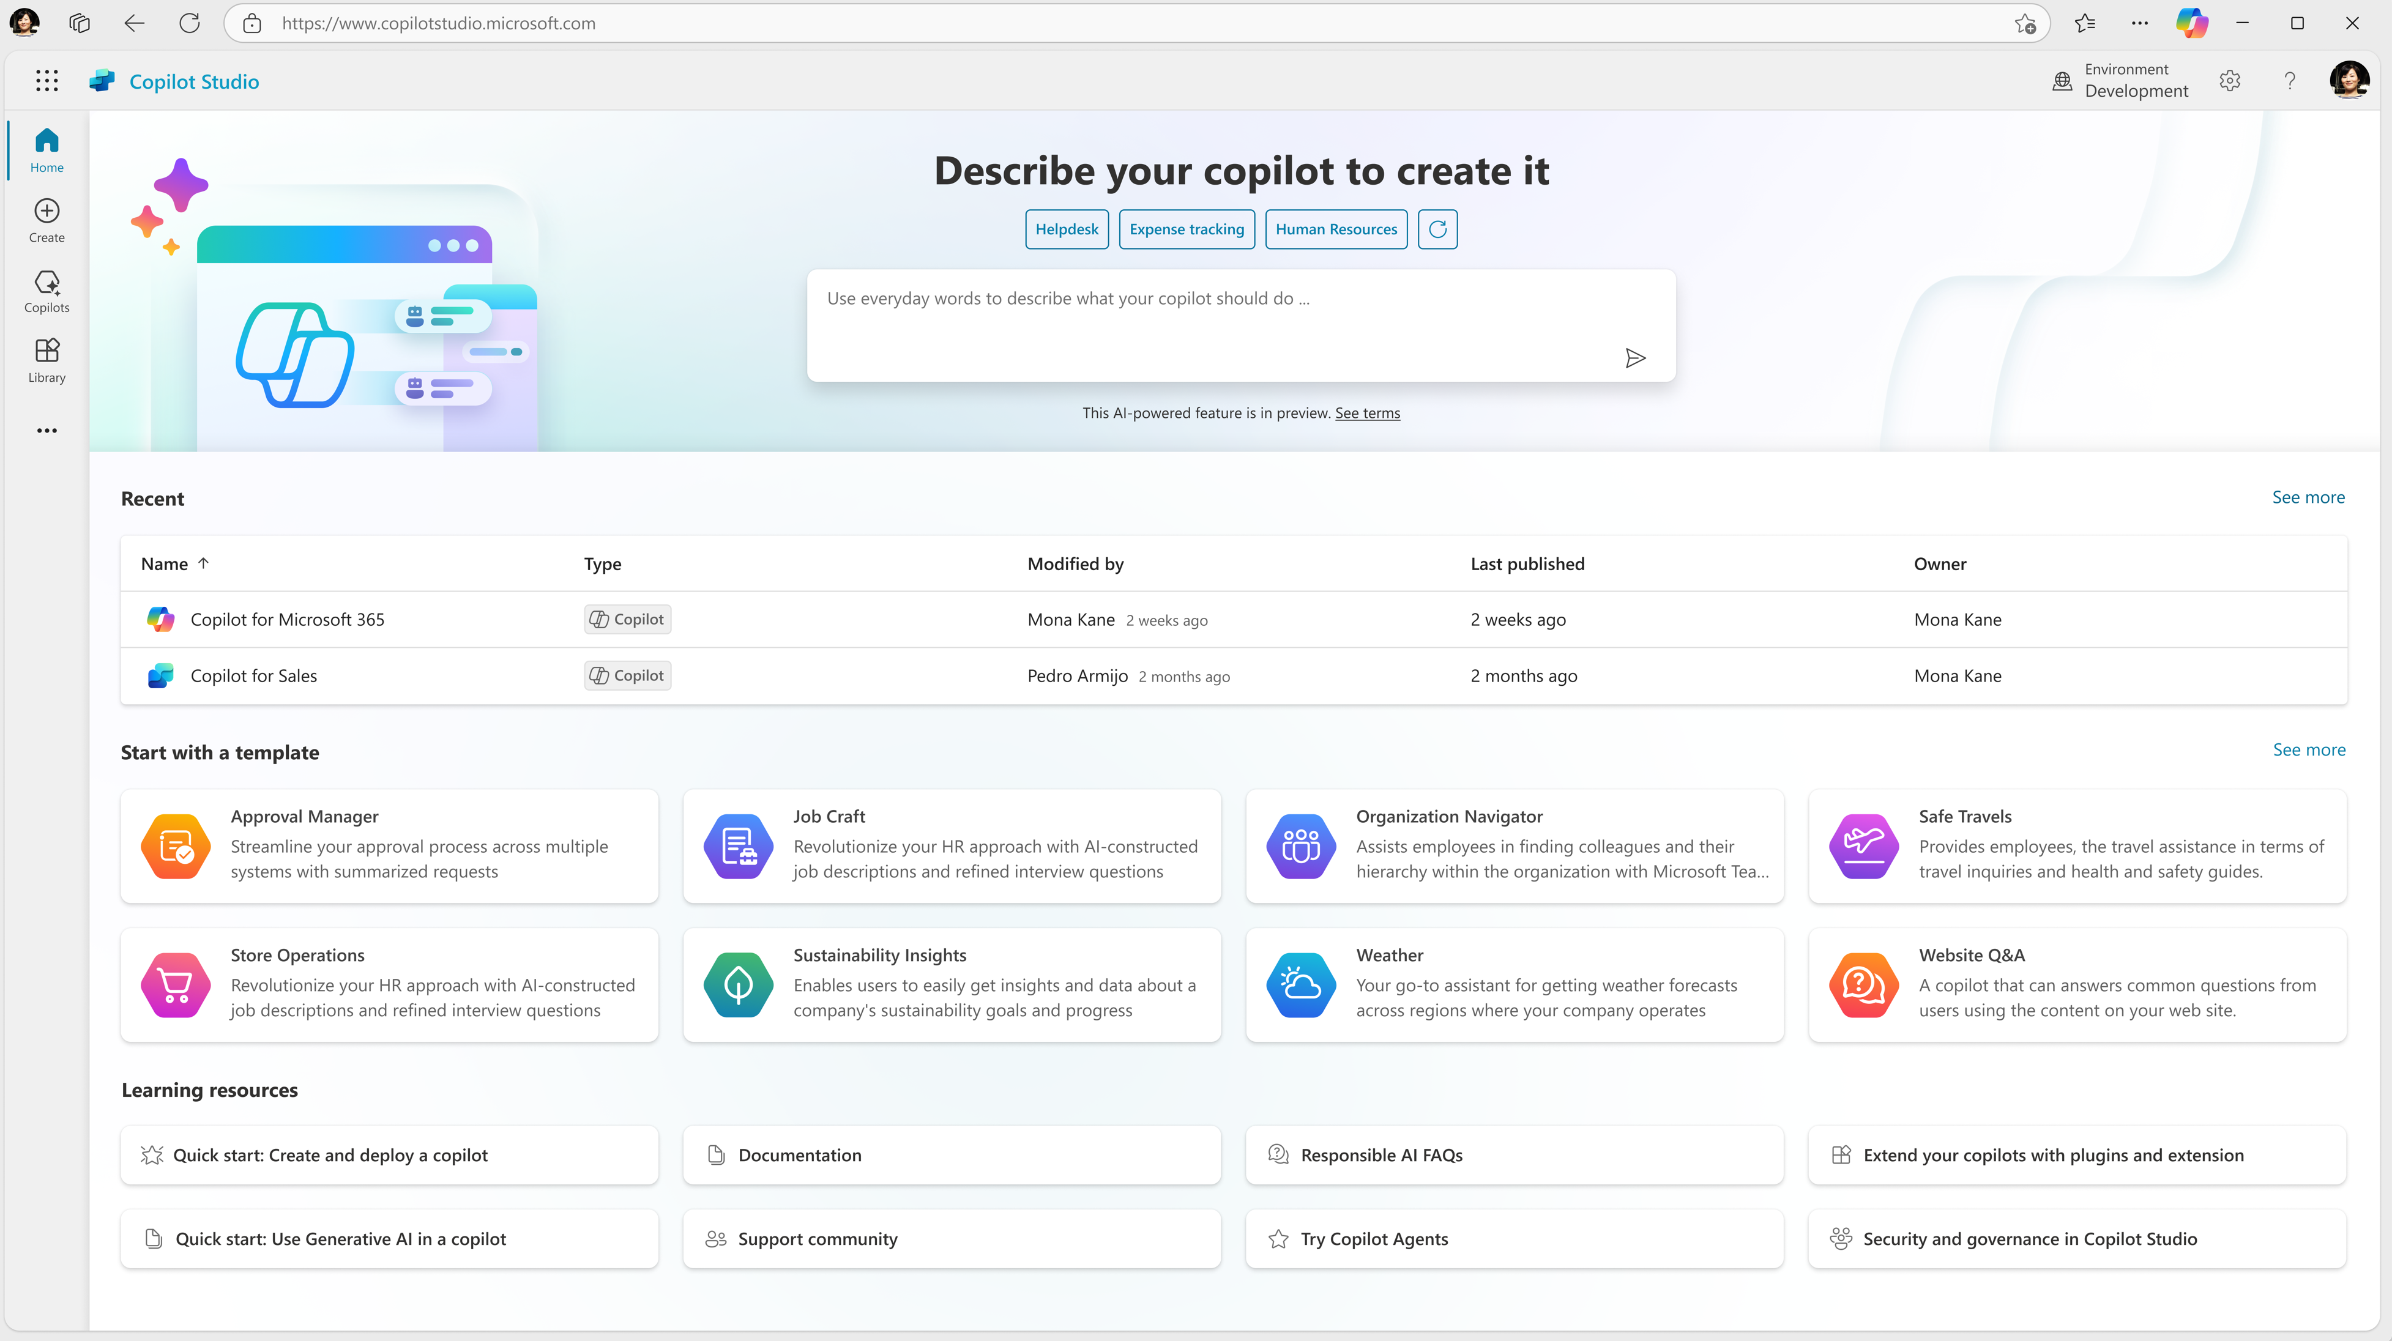
Announcement slide (dark) with color rotation
Copilot Studio
Copilot Studio is an end-to-end conversational AI tool for building your own agents or extending Microsoft 365 Copilot with generative AI, large language models and your data.

Slide 8
So how will the Podcast Marketing Agent work?

Slide 9

microsoft.com/behind-the-tech

Slide 10
Whisper Model
Episode Transcript
Responses API
Retrieve Guest Bio
GPT-4.1
Generate DALL-E Prompt
GPT-4.1
Extract Guest Name
GPT-4.1
Create Social Media Blurb
DALL-E 3
Generate Social Media Image

Slide 11
Prerequisites
An Azure Account
Visual Studio installed with .NET Development workloads
Access to Copilot Studio

Slide 12
Demo Building Podcast Marketing Agent

Slide 13
A quick recap
Laying the Foundation: Azure OpenAI Service
Bridging the Gap: .NET APIs and Custom Connectors
Final Touch: Microsoft Copilot Studio integration

Slide 14
Resources
Azure OpenAI client library for .NET
- aka.ms/AOAI/Dotnet
Download Visual Studio (with .NET Development workloads)
- aka.ms/visualstudio/dotnet
Try Copilot Studio
- aka.ms/TryCopilotStudio

Slide 15
Announcement slide (dark) with color rotation
Thank You

